Slide 1
Comparing the DP, MC, and TD methods
Dynamic programming (DP), that is, the value and policy iteration methods, is a model-based method, meaning that we compute the optimal policy using the model dynamics of the environment. We cannot apply the DP method when we don't have the model dynamics of the environment.
Monte Carlo (MC) method. MC is a model-free method, meaning that we compute the optimal policy without using the model dynamics of the environment. But one problem we face with the MC method is that it is applicable only to episodic tasks and not to continuous tasks.
Another interesting model-free method called Temporal difference (TD) learning. TD learning takes advantage of both DP by bootstrapping and the MC method by being model free.

Slide 2
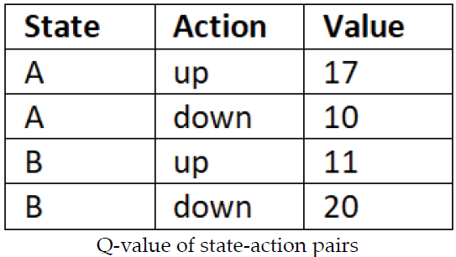
Deep Reinforcement Learning (DRL) algorithms: (Deep Q Network)
Understanding DQN is very important as many of the state of-the-art DRL algorithms are based on DQN.
The DQN algorithm was first proposed by researchers at Google's DeepMind in 2013 in the paper Playing Atari with Deep Reinforcement Learning.
What is DQN ??
The objective of reinforcement learning is to find the optimal policy,that is, the policy that gives us the maximum return (the sum of rewards of the episode).
In order to compute the policy, first we compute the Q function. Once we have the Q function, then we extract the policy by selecting an action in each state that has the maximum Q value.
For instance, let's suppose we have two states A and B and our action space consists of two actions; let the actions be up and down. So, in order to find which action to perform in state A and B, first we compute the Q value of all state-action pairs as shown below:
We select the action up in state A and down in state B as they have the maximum Q value.
We improve the Q function on every iteration and once we have the optimal Q function, then we can extract the optimal policy from it.

Slide 3
Here, the number of states is 2 (A and B) and we have 2 actions in our action space, so our Q table will consist of 2 x 2 = 4 rows containing the Q values of all possible state-action pairs.
Once we obtain the Q values, then we extract the policy by selecting the action in each state that has the maximum Q value.
Let's suppose we have an environment where we have 1,000 states and 50 possible actions in each state. In this case, our Q table will consist of 1,000 x 50 = 50,000 rows containing the Q values of all possible state-action pairs.
In cases like this, where environment consists of a large number of states and actions, it will be very expensive to compute the Q values of all possible state-action pairs in an exhaustive fashion.
Instead of computing Q values in this way, we can approximate them using any function approximator, such as a neural network.
We can parameterize our Q function by a parameter Ө and compute the Q value where the parameter Ө is just the parameter of our neural network.
So, we just feed the state of the environment to a neural network and it will return the Q value of all possible actions in that state. Once we obtain the Q values, then we can select the best action as the one that has the maximum Q value.

Slide 4
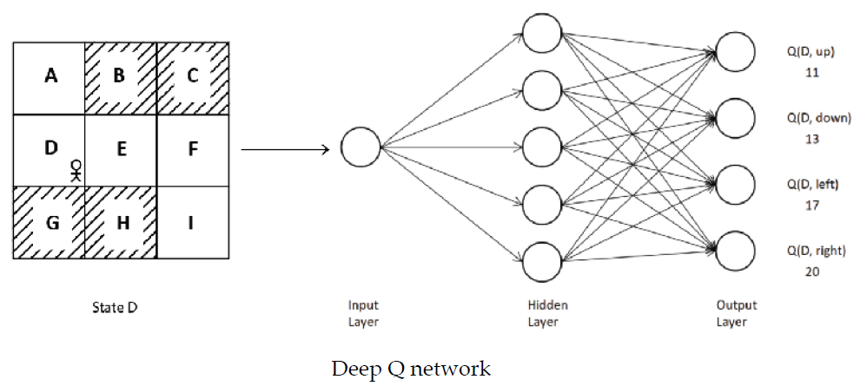

For example, let's consider our grid world environment.
We learned that in the grid world environment, the goal of our agent is to reach state I from state A without visiting the shaded states, and in each state, the agent has to perform one of the four actions—up, down, left, right.
We just feed state D as an input to the network and it returns the Q value of all actions in state D, which are up, down, left, and right, as output.
Then, we select the action that has the maximum Q value. Since action right has a maximum Q value, we select action right in the state D
We can denote our Q function by , where the parameter Ө in subscript indicates that our Q function is parameterized by Ө , and is just the parameter of our neural network.

Slide 5
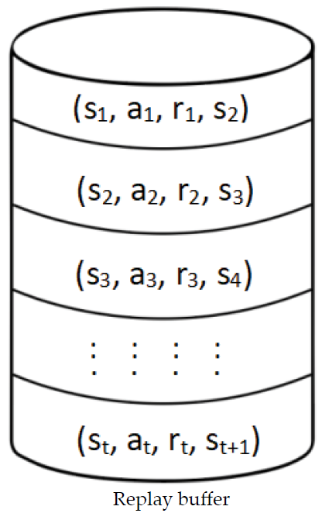
We initialize the network parameter with random values and approximate the Q function (Q values), but since we initialized with random values, the approximated Q function will not be optimal.
So, we train the network for several iterations by finding the optimal parameter . Once we find the optimal , we will have the optimal Q function. Then we can extract the optimal policy from the optimal Q function.
How to train network??
The Q value is just a continuous number, so we are essentially using our DQN to perform a regression task.
We use a buffer called a replay buffer to collect the agent's experience and, based on this experience,we train our network.
Replay buffer
We know that the agent makes a transition from a state s to the next state s’ by performing some action a, and then receives a reward r.
We can save this transition information (s,a,r,s’) in a buffer called a replay buffer or experience replay.
This transition information is basically the agent's experience. We store the agent's experience over several episodes in the replay buffer

Slide 6
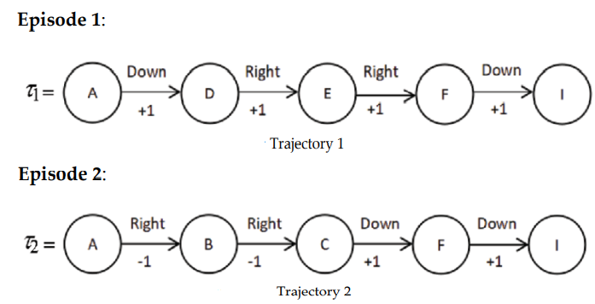
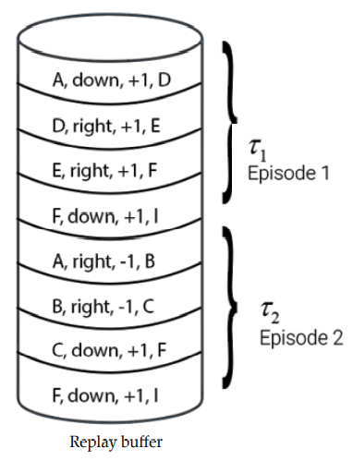
let's consider our favorite grid world environment. Let's suppose we have the following two episodes/trajectories:
We store the transition information by stacking it sequentially one after another. We train the network by sampling a minibatch of transitions from the replay buffer.
Since we are stacking up the agent's experience (transition) one after another sequentially, the agent's experience will be highly correlated.

Slide 7

If we train our network with this correlated experience then our neural network will easily overfit.
So, to combat this, we sample a random minibatch of transitions from the replay buffer and train the network.
Note that the replay buffer is of limited size, that is, a replay buffer will store only a fixed amount of the agent's experience. So, when the buffer is full we replace the old experience with new experience.
A replay buffer is usually implemented as a queue structure (first in first out) rather than a list.
Loss function
DQN basically perform a regression task. We generally use the mean squared error (MSE) as the loss function for the regression task. MSE can be defined as the average squared difference between the target value and the predicted value, as shown here:
Where y is the target value, y-hat is the predicted value, and K is the number of training samples.
We can train the network by minimizing the MSE between the target Q value and predicted Q value.
Target Q value should be the optimal Q value so that we can train our network by minimizing the error between the optimal Q value and predicted Q value.

Slide 8


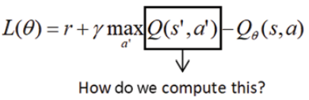
How can we compute the optimal Q value ???
Thus, according to the Bellman optimality equation, the optimal Q value is just the sum of the reward and the discounted maximum Q value of the next state-action pair,
we can define our loss as the difference between the target value (the optimal Q value) and the predicted value (the Q value predicted by the DQN) and express the loss function L as
we compute the predicted Q value using the network parameterized by Ө .
How can we compute the target value? That is, we learned that the target value is the sum of the reward and the discounted maximum Q value of the next state-action pair. How do we compute the Q value of the next state-action pair?

Slide 9


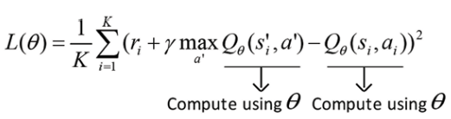
If the next state s’ is terminal then we cannot compute the Q value as we don't take any action in the terminal state, so in that case, the target value will be just the reward, as shown here:
We train our network by minimizing the loss function. We can minimize the loss function by finding the optimal parameter Ө . So, we use gradient descent to find the optimal parameter . We compute the gradient of our loss function and update our network parameter as:
Target network
There is a minor issue with loss function while computing max term. We compute this Q value of the next state-action pair in the target and predicted Q values using the same network parameterized by Ө , as shown here.
The problem is since the target and predicted value depend on the same parameter Ө , this will cause instability in the MSE and the network learns poorly. It also causes a lot of divergence during training.

Slide 10
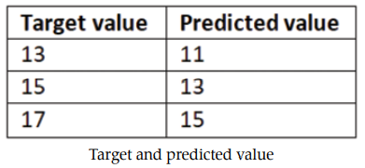
Let's understand this with a simple example.
We know that we try to minimize the difference between the target value and the predicted value. So, on every iteration, we compute the gradient of loss and update our network parameter Ө so that we can make our predicted value the same as the target value.
Let's suppose in iteration 1, the target value is 13 and the predicted value is 11. So, we update our parameter Ө to match the predicted value to the target value, which is 13.
But in the next iteration, the target value changes to 15 and the predicted value becomes 13 since we updated our network parameter Ө .
So, again we update our parameter Ө to match the predicted value to the target value, which is now 15. But in the next iteration, the target value changes to 17 and the predicted value becomes 15 since we updated our network parameter Ө
Thus, the predicted value keeps on trying to be the same as the target value, but the target value keeps on changing due to the update on the network parameter Ө .

Slide 11
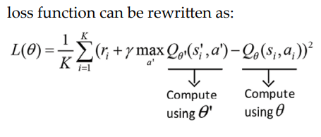
How can we avoid this?
To do this, we introduce another neural network called a target network for computing the Q value of the next state-action pair in the target. The parameter of the target network is represented by Ө’ .
Main deep Q network, which is used for predicting Q values, learns the optimal parameter using gradient descent. The target network is frozen for a while and then the target network parameter Ө’ is updated by just copying the main deep Q network parameter Ө .
Freezing the target network for a while and then updating its parameter Ө’ with the main network parameter Ө stabilizes the training.

